Slide 1
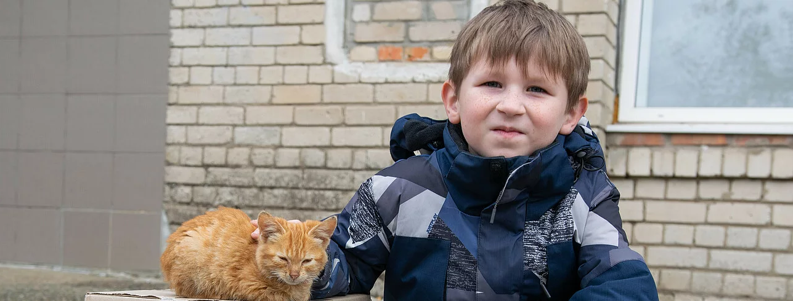
Hilfswerk INTERNATIONAL
IN UKRAINE
12.09.2025, Odesa

Slide 2
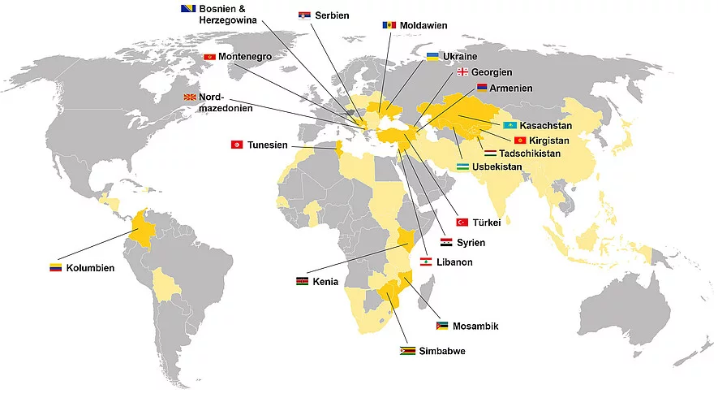
HILFSWERK INTERNATIONAL
Since 1978
HQ in Vienna, Austria
30+ countries
Local HWI offices in Bosnia, Ukraine, Moldova, Tajikistan, Mozambique, Tunisia, Colombia, Lebanon
In Ukraine officially since 2022

Slide 3
HWI IN UKRAINE
Total humanitarian support budget: over EUR 13 million
13 projects (9 already implemented)
More than 700 000 beneficiaries
12 oblasts covered
70 000+ humanitarian kits
Support of critical infrastructure
4000+ PSS sessions
5 Help-Points (and 2 more are planning)
Over 20 million liters of water

Slide 4

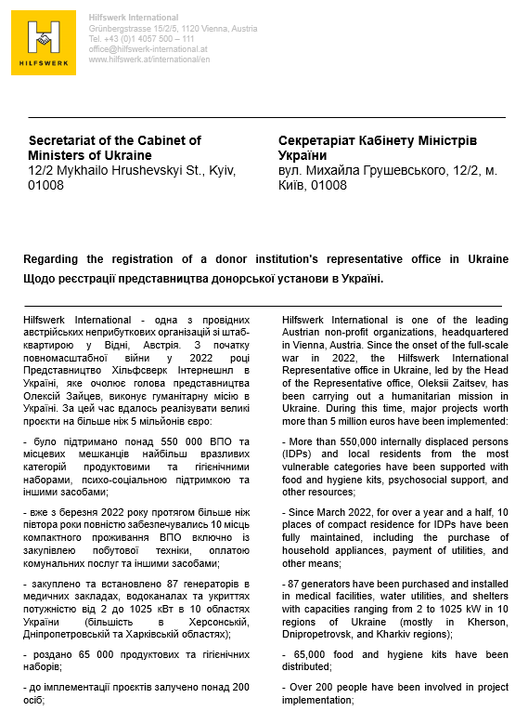
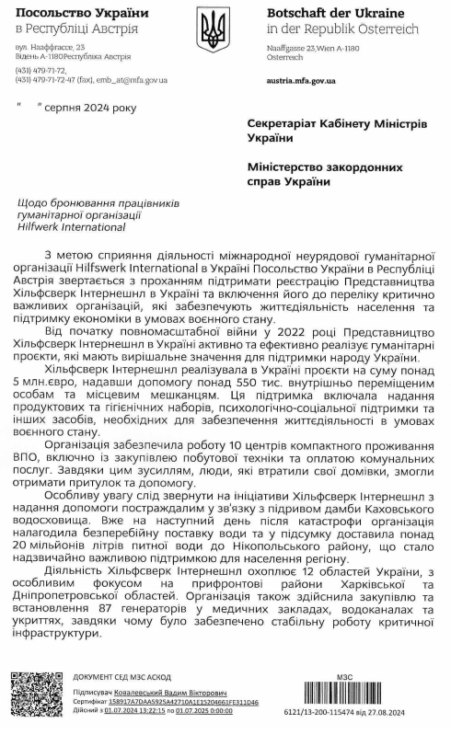
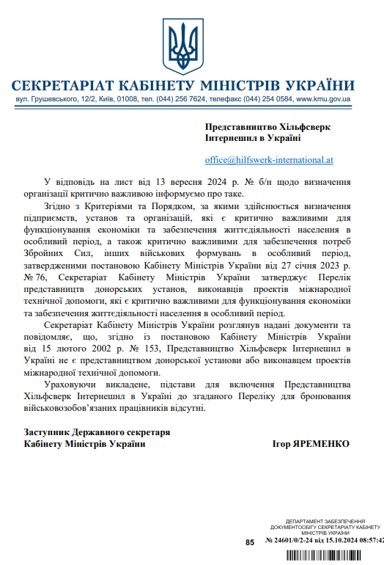
List of critical organizations

Slide 5
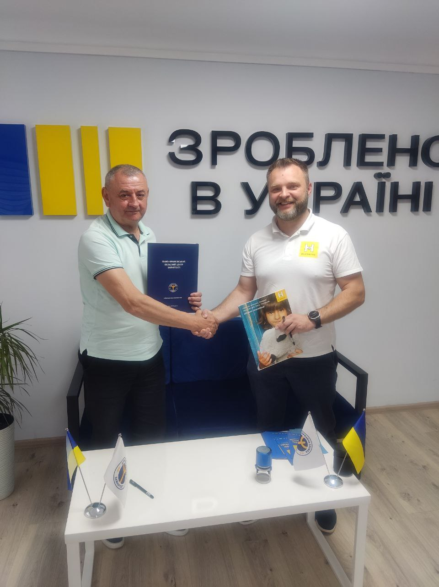
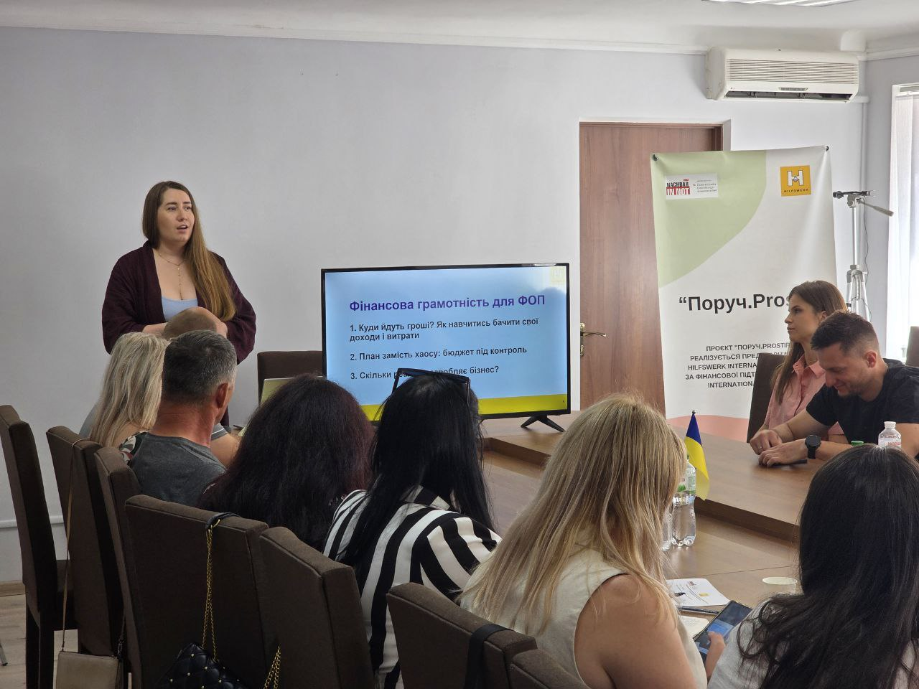
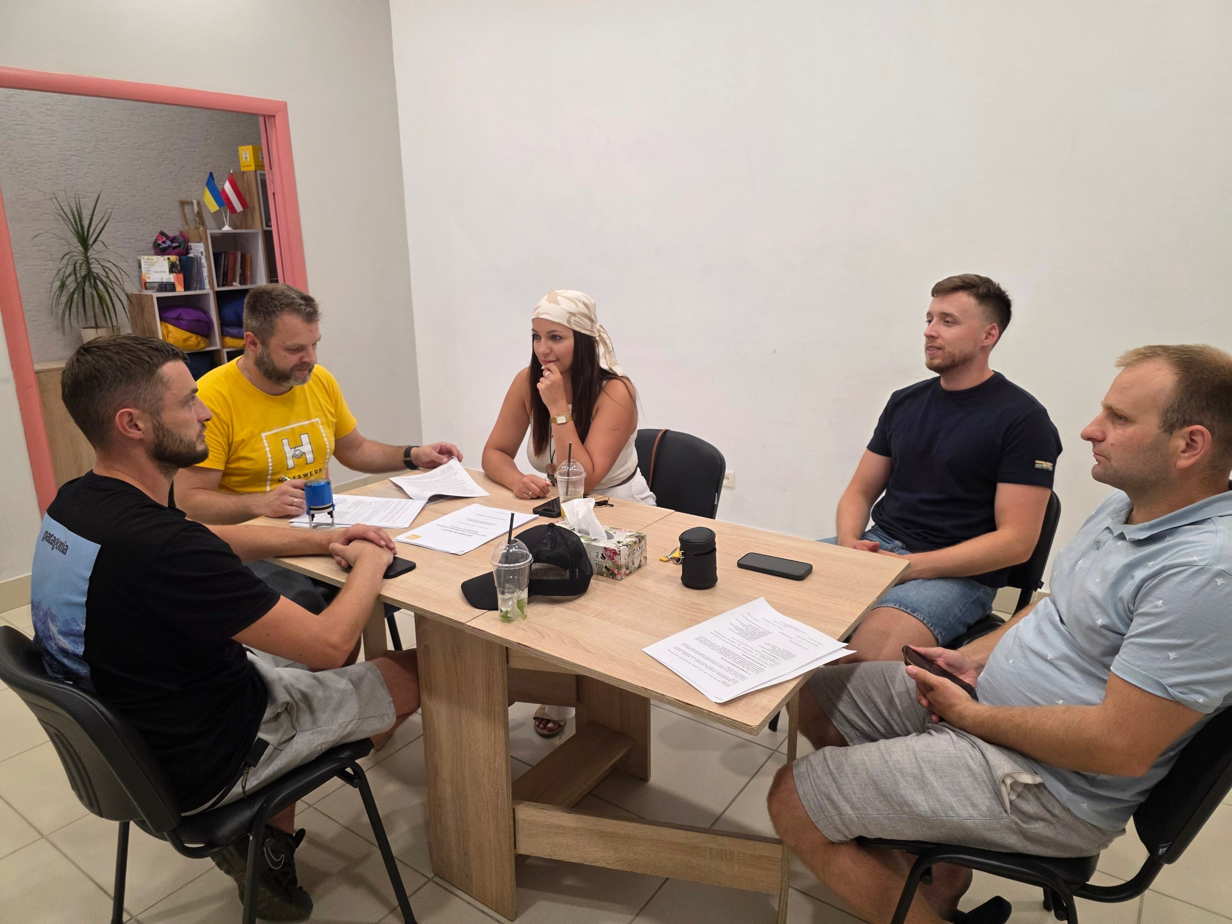
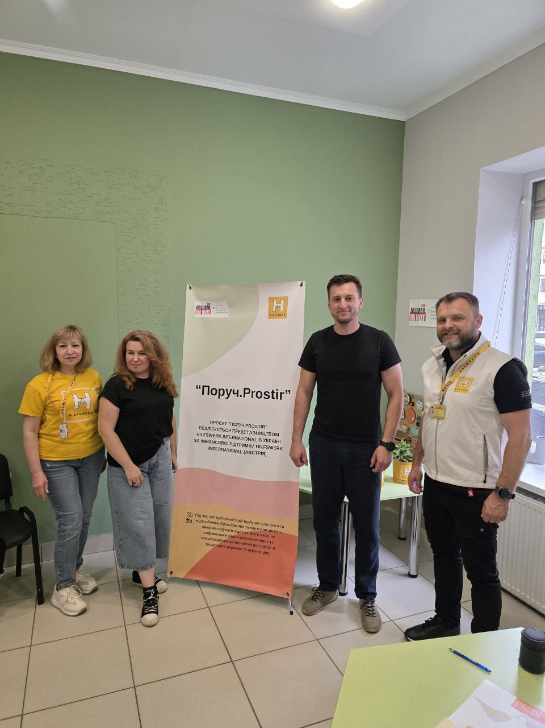
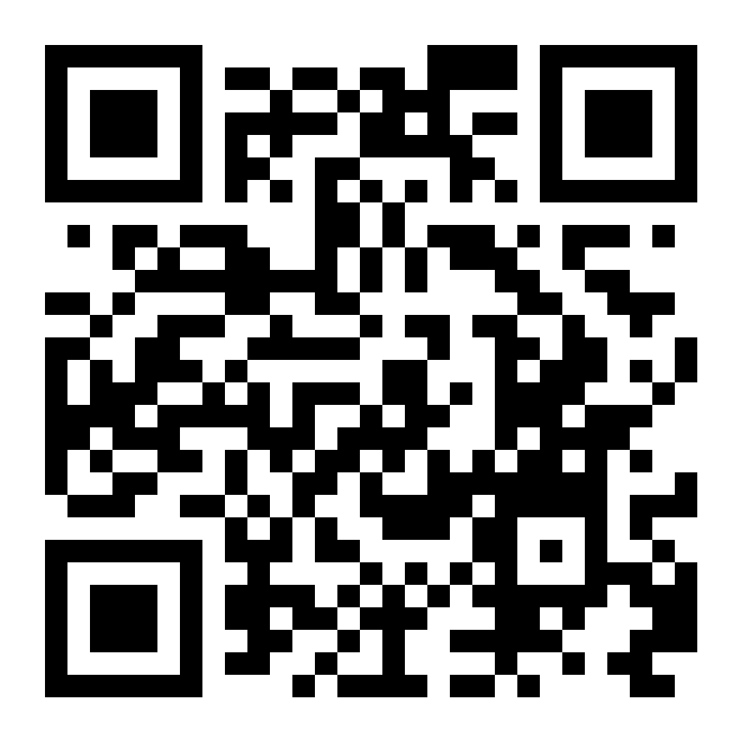
Business grants
Сooperation with the Regional Employment Center
Top-up grants of EUR 5000,00
Trainings and consulting
Women empowerment
Preferences to relocated businesses, IDPs, and women
Grants are non-refundable

Slide 6
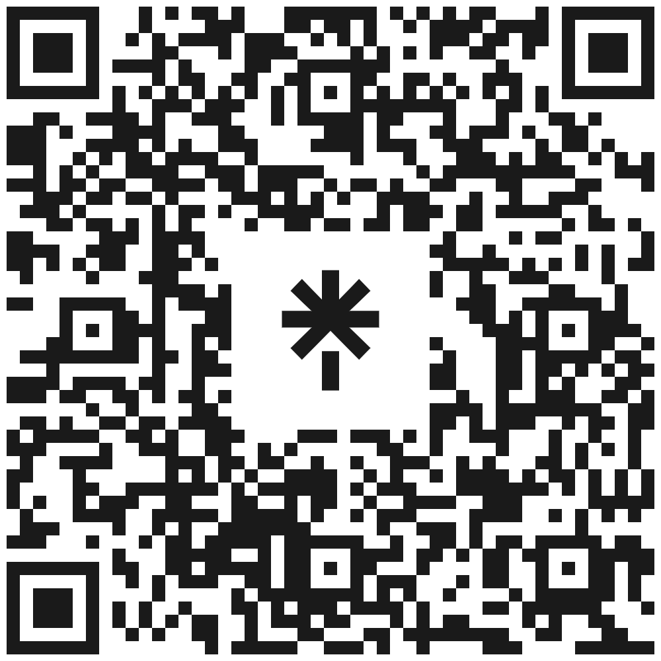
Hilfswerk international
Thank you!

Slide 7
Hilfswerk INTERNATIONAL
IN UKRAINE
Thank you for your attention
12.09.2025, Odesa

